Slide 1
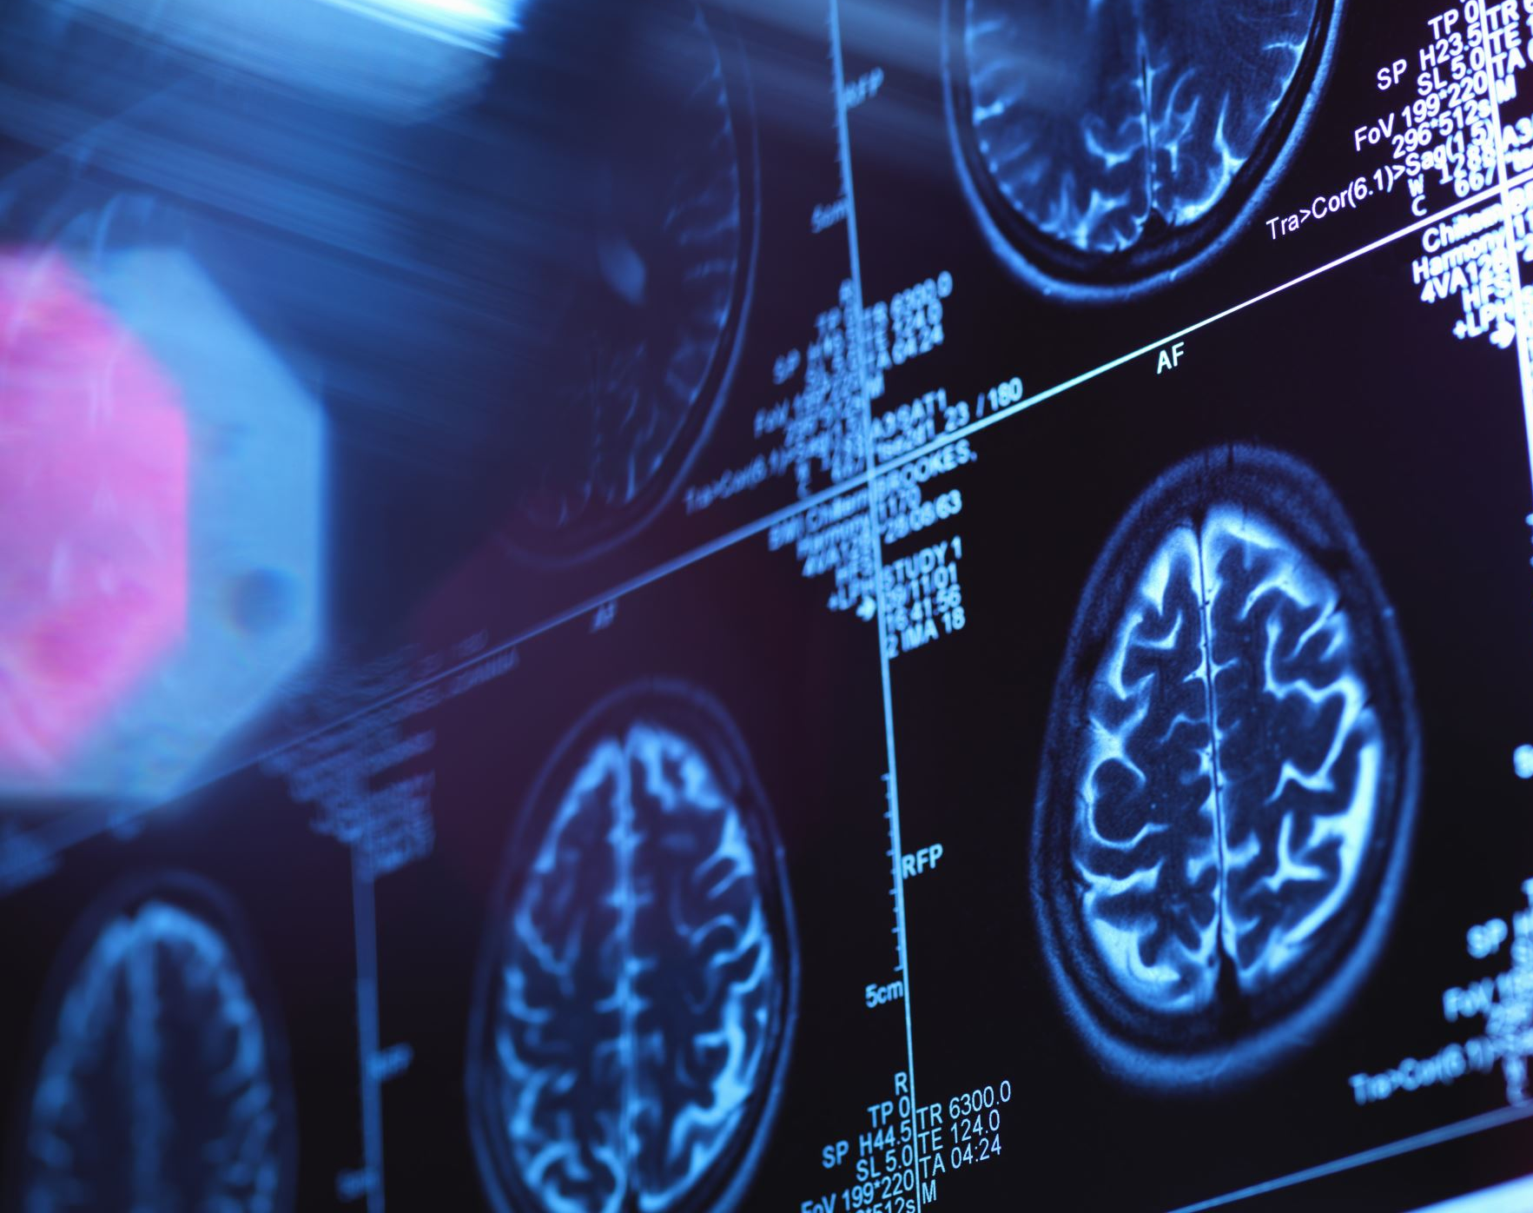
Retrieval Augmented Generation
Brian Msane

Slide 2
Agenda
Intro to LLMs
Limitations of LLMs
RAG saves the day
RAG Architecture
Applications of RAG
Limitations of RAG
Optimizing RAG
Conclusion

Slide 3
LLMs
Data is collected from internet crawls
Pre-training (GPUs, Transformer backbone, runs for days)
The model weights are more or less lossless compression of the internet.
After this, the model undergoes fine-tuning. [user, assistant messages]
Here the model is trained to be good at some tasks. Think of GPTs by OpenAI
The model performs next-word prediction at inference and when we use it we normally use one-shot inference.
"The result is as good as the prompt" - OpenAI. This emphasizes the need for better prompt engineering. (Zero-shot, one-shot, few-shots prompting)

Slide 4
Limitations of LLMs
Training data is not up-to-date
Gpt-3.5-turbo -> Upto Septermber 2021 (OpenAI)
Gpt-4-turbo -> Upto December 2023 (OpenAI)
No enterprise information
False information (Hallucination)
Privacy concerns
Biased content (Responsible AI)
The information used when training the LLMs contains cultural biases
Etc.,

Slide 5
RAG saves the day!
Ingest your enterprise or personal data into the model
Context window
Gpt-3.5-turbo -> 16,385 tokens
Gpt-4-turbo -> 128,000 tokens
Reduced Hallucination. Factual answer else no response command!
Since you are using the reasoning, and language representation aspects of the model you are less likely to experience the biases

Slide 6
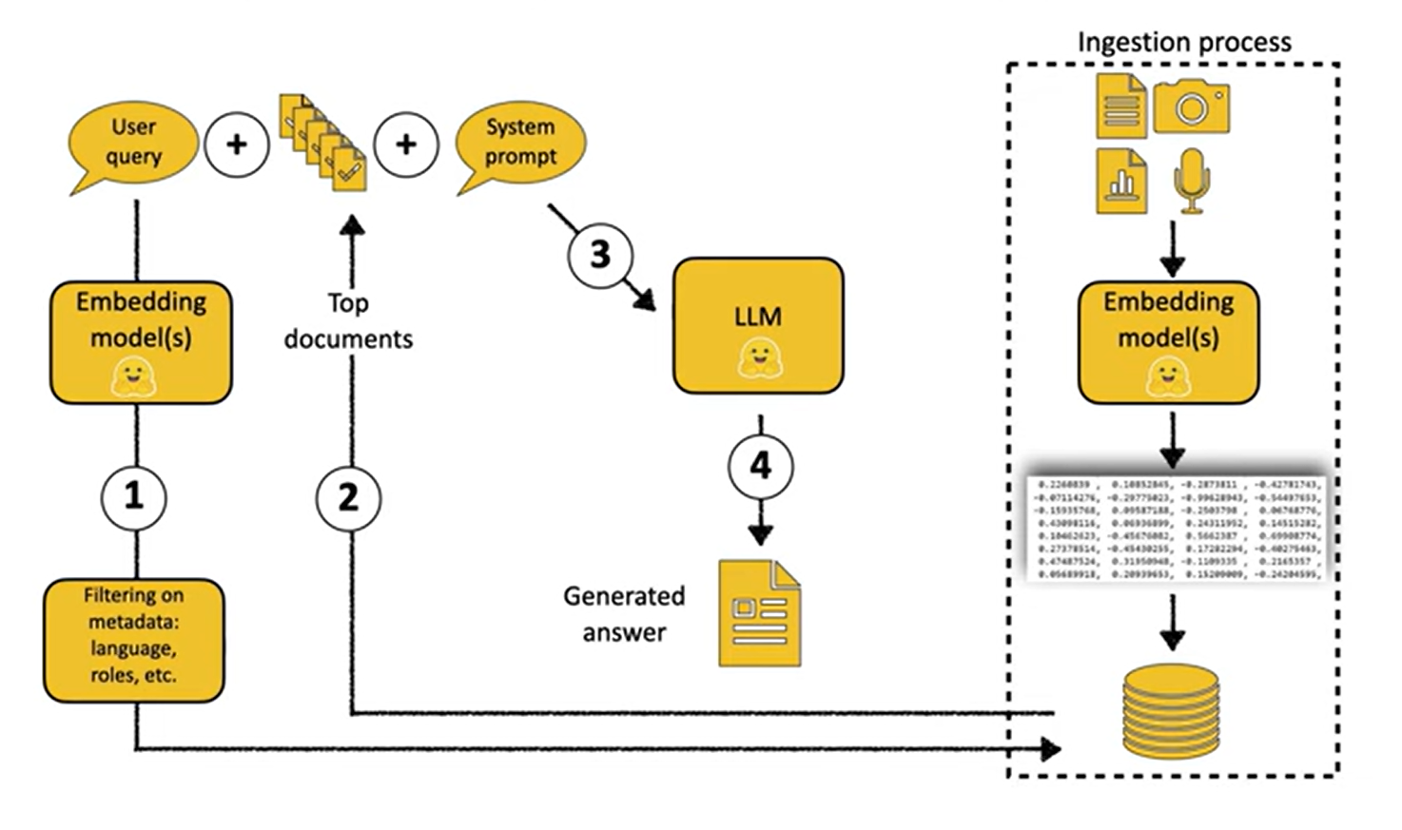
RAG Architecture
The information to be ingested is collected and organized.
From there, it is split into manageable chunks (the idea is the each has one detail)
Retrieval
Generation

Slide 7
Applications of RAG
Personal RAG
Have your documents on Drive, Dropbox, WhatsApp conversations, basically anywhere
Connect them all and query at once.
Information Intensive Tasks
Need for factual information
Chatbots and Customer Service
Etihuku Use Case (Demo)
Store information about the company, its projects, employees, and all
When an employee has a question about a project, they simply ask query RAG.
Follows the architecture and brings back a detailed response
Etc.

Slide 8
Limitations of RAG
Latency.
Even more privacy issues when you give your proprietary data into closed source model (OpenAI)
On-device language models can be used but they have limitations (Train model, train assistant)
Llama3 70B (parameters and run files)
Questions within the pipeline
Which is the best splitting strategy?
How much information should be retrieved? [Retrieval Strategy]
What is the best embedding model?
What is the suitable vector database?
RAG evaluation is mandatory! (RAGAS)

Slide 9
Optimizing RAG
Routing
Web search, multiple data sources
GraphRAG
Use a graph database to represent information
Entities and relationships are captured
Query Optimization Strategies
Multi-Query (Produce multiple questions related to user query)
Decomposition (What car does the president of South Africa drives?)
RAG Fusion (Reciprocal Rank filter after decomposition)
Adaptive RAG
Memory (Keep track of conversations)

Slide 10
Optimizing RAG
Multi-modal RAG
Text, Video, Images, Audio, etc,
Embedding models and vector databases to store each format
Agentic Workflow (AI Agents Architecture)
AI agents take self-determined tasks to accomplish pre-defined goals
The architecture has four main design principles
Reflection
Tool use
Multi-agent collaboration
Planning (breaking down high-level tasks into smaller ones)
"GPT-3.5 can reach the reasoning capabilities of GPT-4 when used in an agentic workflow" - Andrew Ng

Slide 11
Conclusion
LLMs have extra-ordinary reasoning capabilities.
We can overcome their limitation through the use of RAG
With the optimization strategies seen earlier, RAG can be harnessed so it works best in our environment
The LLMs that are a foundation are of RAG are improved now and then (Groq, GTP-5, etc,). Even the open-source community is growing and becoming better (Llama3, Mistral, etc,.)
This is a fast-paced industry so more and more enhancements will come in time.
Overall, let's do the most with RAG....

Slide 12
Thank you!

